Slide 1
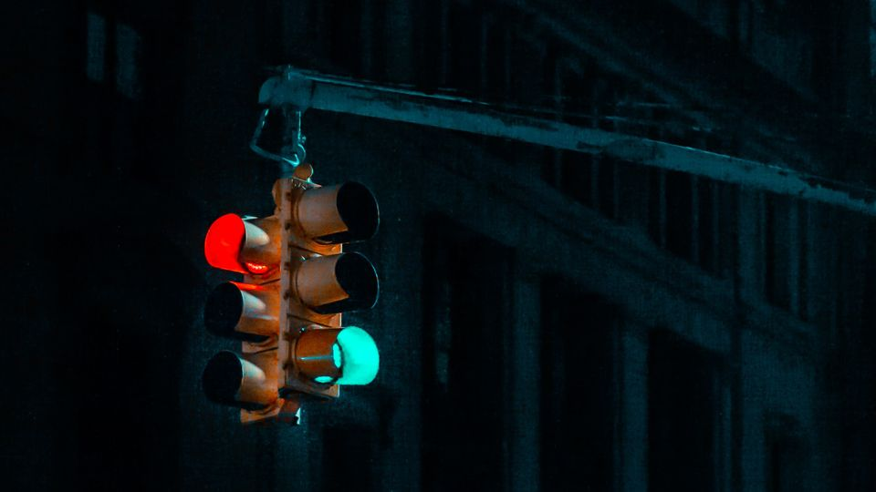
TRAFFIC MANAGEMENT SYSTEM USING – “IOT”
TEAM NAME: Power Seekers
NAME OF THE COLLEGE:
RAGHU INSTITUTE OF TECHNOLOGY
(RAGHU ENGINEERING COLLEGE-R.E.I)

Slide 2
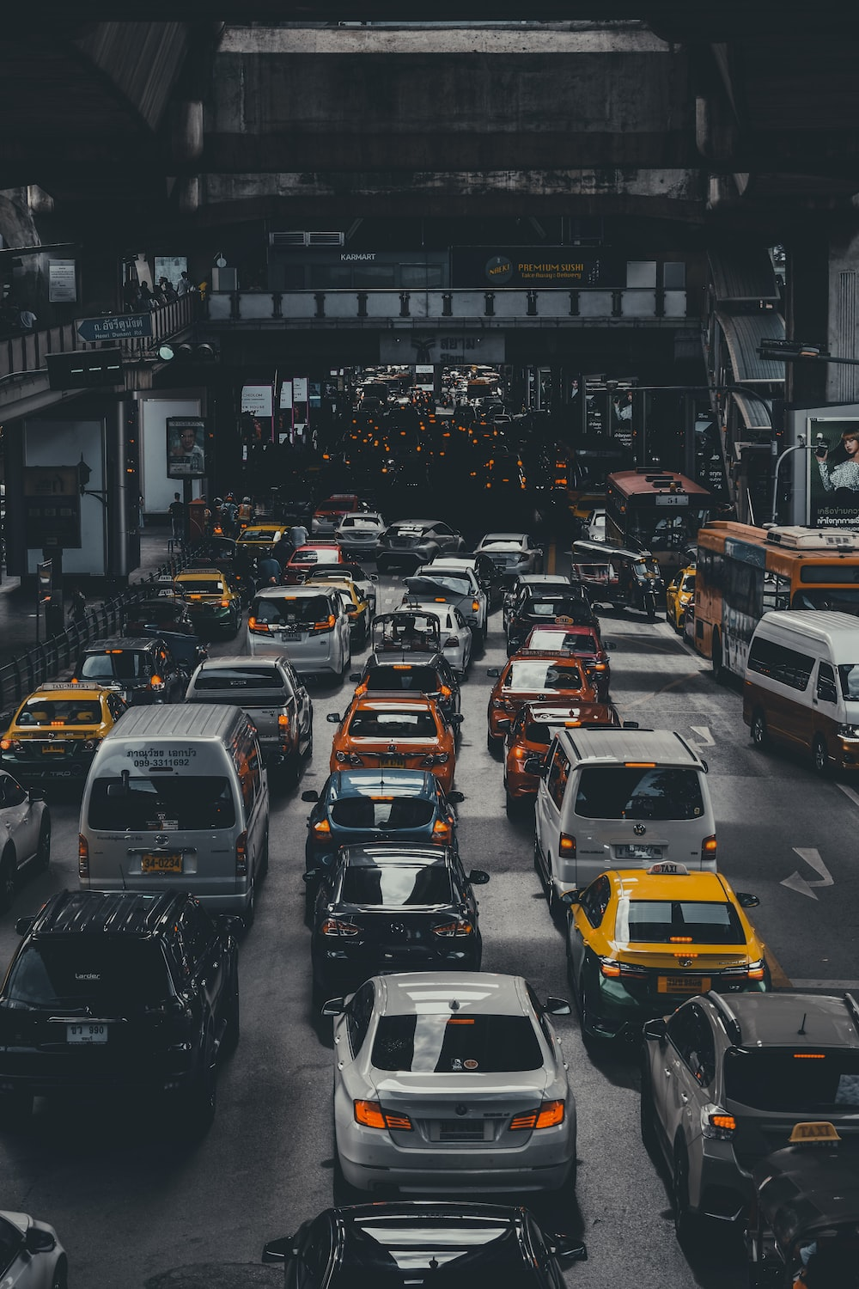
WHAT IS “TRAFFIC”?
Traffic in English is taken from the Arabic word taraffaqa, which means to walk along slowly together.
Traffic on roads may consist of pedestrians, ridden or herded animals, vehicles and streetcars, either singly or together, while using the public way for purposes of travel.
It is the rising problem in all mega cities and also developing cities.

Slide 3
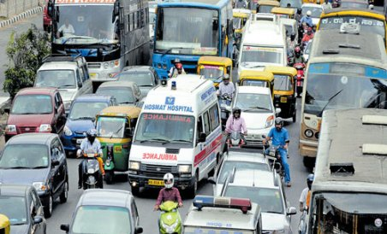
Problem
Due to Urbanization ,is a challenge for Organizations that manage the city’s infrastructure and are responsible for ‘comfort and safety’.
The number of cars is growing traffic is becoming more intense , so congestion and traffic accidents are common.
Meanwhile ,traffic control systems have insufficient coverage to control all city.
Due to traffic the EMERGENCY vehicles like Ambulance cannot reach the hospitals in time.

Slide 4
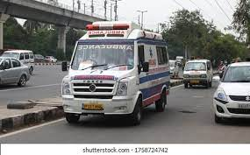
Solution
Smart parking
Smart ambulance
IoT sensors in parking lots can transmit information about accessible parking spaces in real-time.
Video surveillance systems and road sensors can help locate incidents and report them to the nearest emergency room.
IoT traffic light
IoT Big Data solutions can analyze this information, determine alternative routes, and improve traffic signaling to reduce congestion. Roadside lights can also work by the weather sensors installed on them.

Slide 5
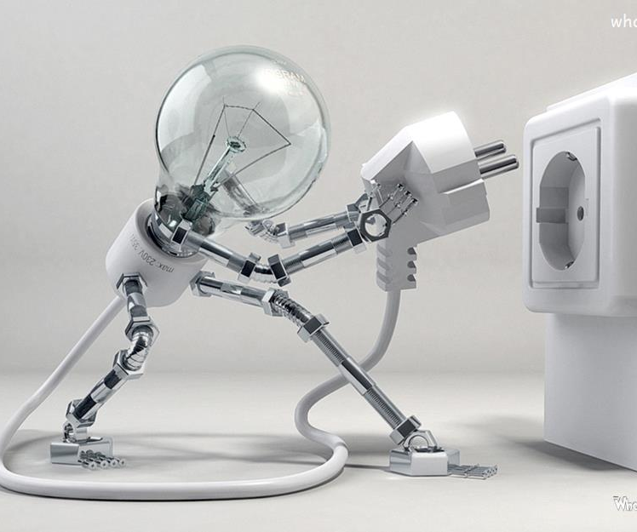
Why and how our solution is unique?
Providing priority access to police , fire and ambulance services.
Can increase the safety of transportation systems around the world.

Slide 6


